Slide 1

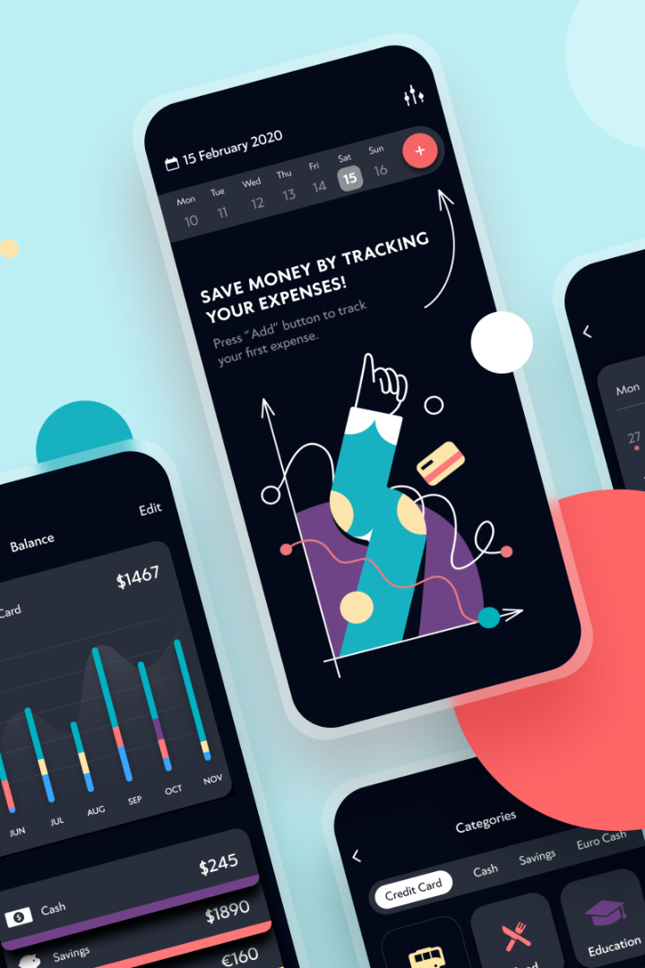
Personal Finance Tracker and Advisor
Chada Yashodhan -21BRS1456
Krishna Vyas -21BAI1715
Varanasi Sai Charan -21BCE5870
Surya Kiran C -21BCE1110

Slide 2
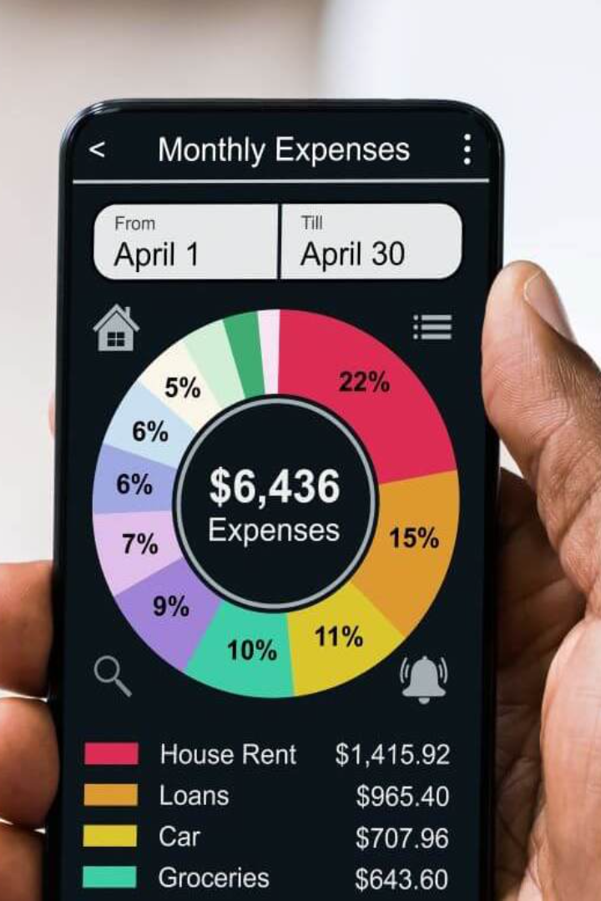
Introduction
Welcome to our finance tracker platform! With our application, you can easily keep track of your expenses, monitor your incomes, and manage your savings.
But that's not all! Our platform goes beyond just tracking and monitoring. We also offer personalized advice based on your financial data. You can add savings goals to help you achieve your financial goals.
Ready to take control of your finances? Sign up today and start your journey towards financial success!

Slide 3
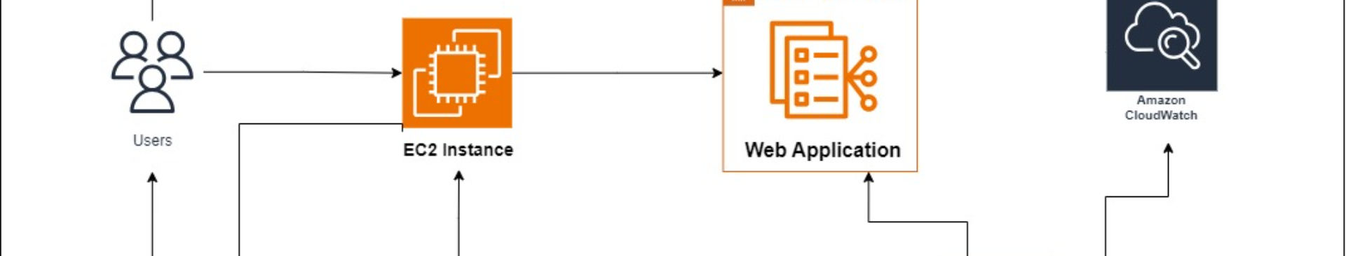
Overview of the Project
We present a cloud-based finance tracker built on AWS, utilizing a range of services including EC2, RDS, Lambda, S3, CloudWatch, and SNS. The platform offers spending tracking, investment monitoring, and savings oversight with advices.

Slide 4

Project Objectives
1)Financial Wellness
2)Interactive Charts
Enable users to achieve financial wellness through better spending tracking, investment monitoring, and savings oversight.
Provide users with visually appealing and interactive charts to gain valuable insights into their financial habits.
3)Smart Budgeting
4)Personalized Advice
Offer budgeting tools and goal setting features to help users establish and adhere to their financial targets.
Utilize user behavior and financial data to provide advice and actionable steps for improved financial decision making.

Slide 5
Specific Goals, Outcomes
Deliver a user-friendly interface, data storage, personalized financial advice, high availability, and interactive charting features.
Project Scope
Designed to handle the financial data of individual users.
Scope Boundaries
But due to constraints, we were only able to complete the hosting of the website on EC2, and we only got used to limited services in our project . Looking forward to future opportunities to expand and enhance this platform.

Slide 6
Individual Contributions
C Surya Kiran
Chada Yashodhan
contributed in html, js ,hosted front end in ec2, lambda, cloudwatch, ppts
contributed in js, html, rds, sns, stored file in s3, ppts, backend in lambda, cloud watch
Krishna Vyas
Varanasi Sai Charan
contributed in html, sns, hosted frontend in ec2, ppts, arch diagram, cloudwatch, css
contributed in js, ppts, stored files in s3, backend in lambda, css, rds, arch diagram

Slide 7


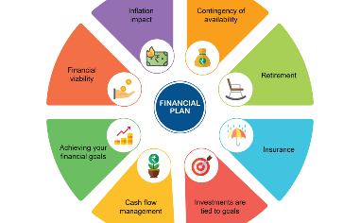
Project Architecture
AWS Services Used
Interaction Between Services
Key Concepts
EC2, RDS, Lambda, S3, CloudWatch, SNS.
Real-time spending tracking, investment monitoring, savings oversight, budgeting, goal setting, and personalized advice.
EC2 hosts the platform, RDS stores data, Lambda offers personalized advice, S3 sgives transaction data, CloudWatch monitors system metrics, and SNS enables user communication.

Slide 8
Detailed Explanation of Services Used:
EC2
RDS
Our front-end is served by EC2 instances, providing a secure and reliable platform for our users.
Our data for income, expenses,savings will be stored in rds.
Lambda
S3
Our data for personalized advice and actionable steps for users will be stored here.
S3 provides the transaction document for users.
CloudWatch
SNS
CloudWatch monitors all the services.
SNS Communicate with users for alerts and notifications via Email.

Slide 9
Key Concepts
In this section, we'll explore the fundamental concepts that drove our project.
1
UI and UX
We focus on designing sleek and intuitive User Interfaces, with streamlined User Experiences that make it easy and fun for users to browse and interact with our platform.
Backend Architecture
2
We optimize our Backend architecture for scalability, with a strong emphasis on performance, redundancy, and scalability to meet the demands of a growing user base.
3
High Availability
Implemented high availability to minimize downtime and ensure data reliability.

Slide 10
Key Services
1
Elastic Compute Cloud (EC2)
Our user interface is powered by Amazon EC2 instances. These instances offer scalability and flexibility. We can easily add or remove instances to meet changing user demands, resulting in a responsive and efficient platform.
Lambda
2
Our backend is done by lambda,Processed data for personalized advice and alerts.
3
Amazon S3
Users Transactions data will be stored by using s3.

Slide 11
Challenges and Solutions
Challenge
Solution
Initially, we faced challenges hosting our website on AWS EC2. We faced issues with connecting our website with ec2 instance, configurations and deployment.
After thorough troubleshooting and research, we discovered that using HTTP was the solution. It allowed us to efficiently transfer website files to EC2 instances, simplifying the hosting process.

Slide 12
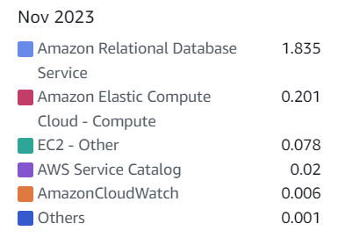
Cost Analysis
Cost breakdown for each AWS service used in the project.
Chada Yashodhan -21BRS1456 - 0.8$
Krishna Vyas -21BAI1715 -0.45$
Varanasi Sai Charan -21BCE5870 -0.35$
Surya Kiran C -21BCE1110 -0.8$

Slide 13

Security Measures
1
Authentication Steps
2
Data Protection:
User Registration:
Ensure data security and privacy through encryption at rest in Amazon RDS and server-side encryption in Amazon S3.
Users provide a valid email address and create a name during registration. Secure login using a combination of email and name.

Slide 14

Lessons Learned
1
Technical Insights
As we developed the platform, we learned several valuable lessons, including the importance of efficient database design, the benefits of using scalable and flexible cloud infrastructure, and the crucial role of user experience in creating a successful and engaging platform.
One specific aspect that stood out was the implementation of a cloud database. By utilizing a cloud database, we were able to achieve improved scalability, reliability, and accessibility for our platform.

Slide 15

Lessons Learned
2) Process Insights
• Seamless communication fostered a shared understanding of project objectives, aligning our efforts and facilitating steady progress.
•As a team, we have not only achieved our project goals but have also gained valuable expertise

Slide 16
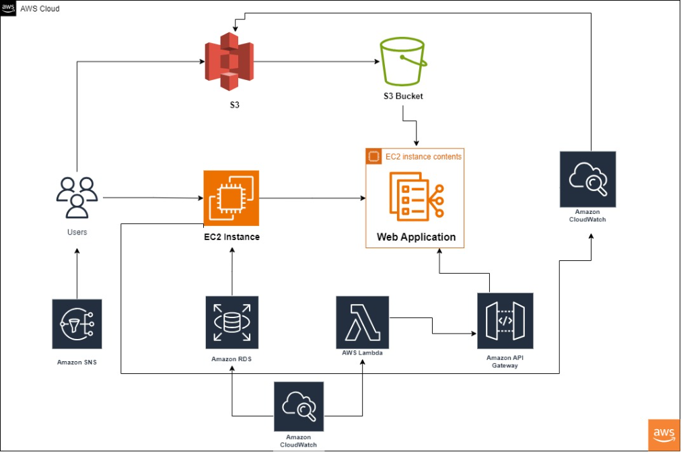
Architecture Diagram:

Slide 17
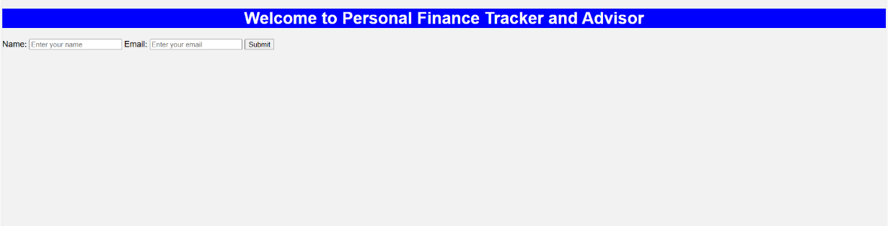
ScreenShots:
Welcome Page:
This is our welcome page by entering name and email we can login successfully.

Slide 18
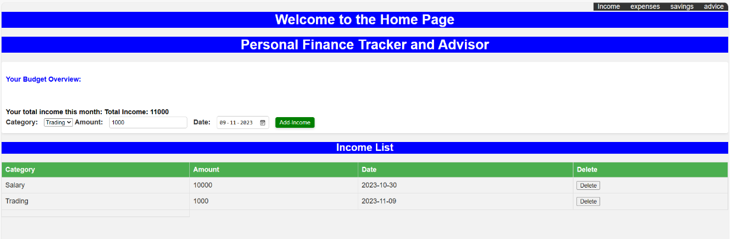
Income Page:
This is our income page in which we can store the incomes from various sources and it will the data.

Slide 19
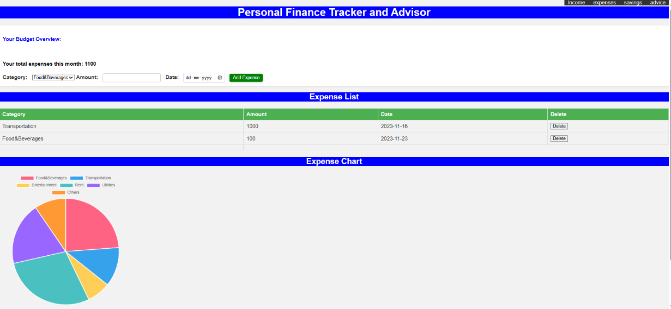
Expenses Page:
This is our expenses page where we can add our expenses for different categories and see the pie chart visually.

Slide 20
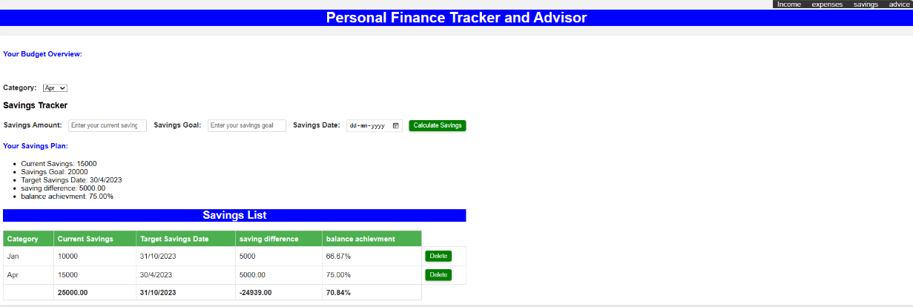
Savings Page:
This is our savings page in which you can add your saving amount and keep savings goal for different months and check your balance achievement combinely.

Slide 21
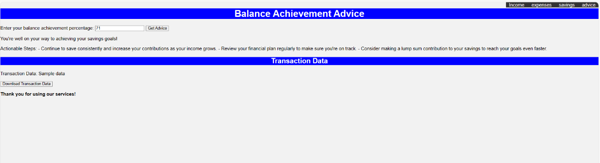
Advice Page:
This is our advice page in which we will enter our balance achievement percentage and get our advice and actionable steps for your future.

Slide 22
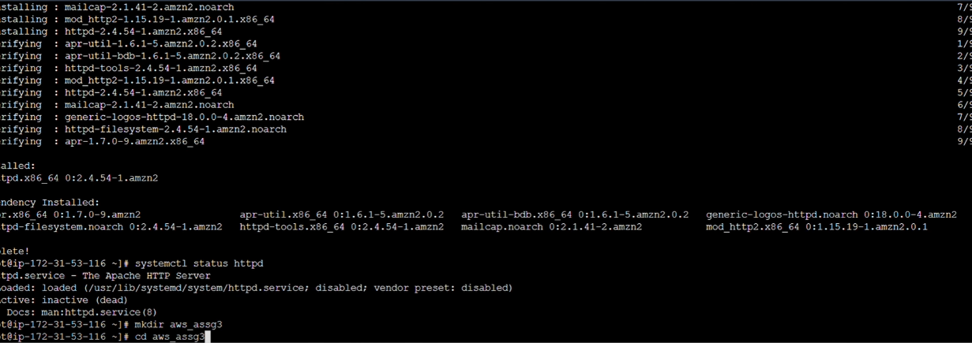
Using EC2 To host our website:

Slide 23
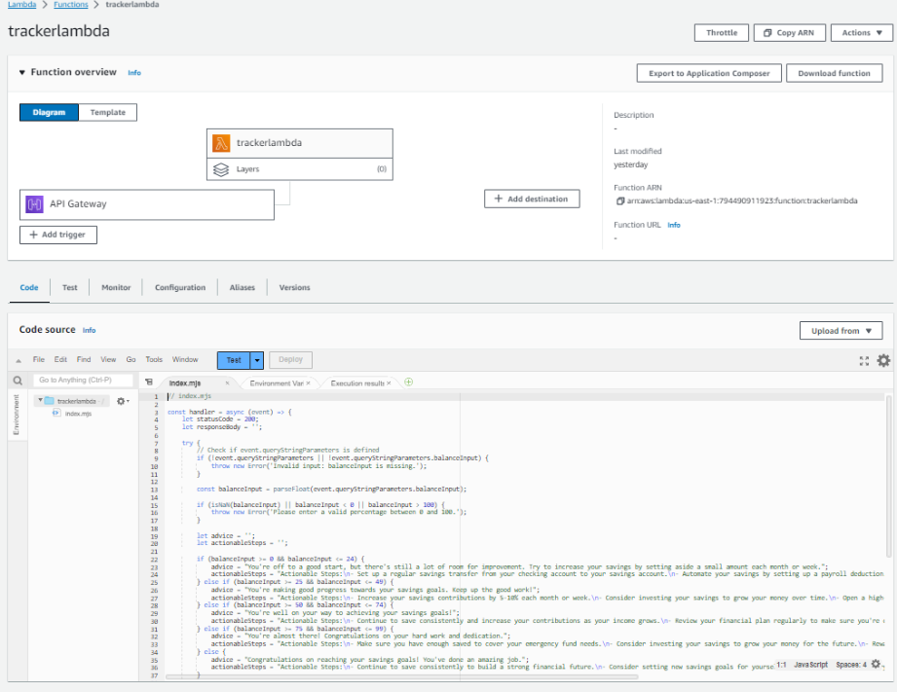
Using lambda function for backend:

Slide 24
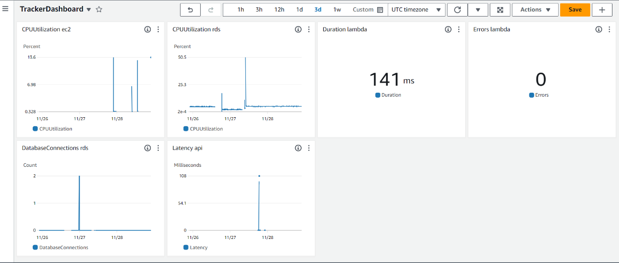
Cloud Watch for monitoring our services:

Slide 25
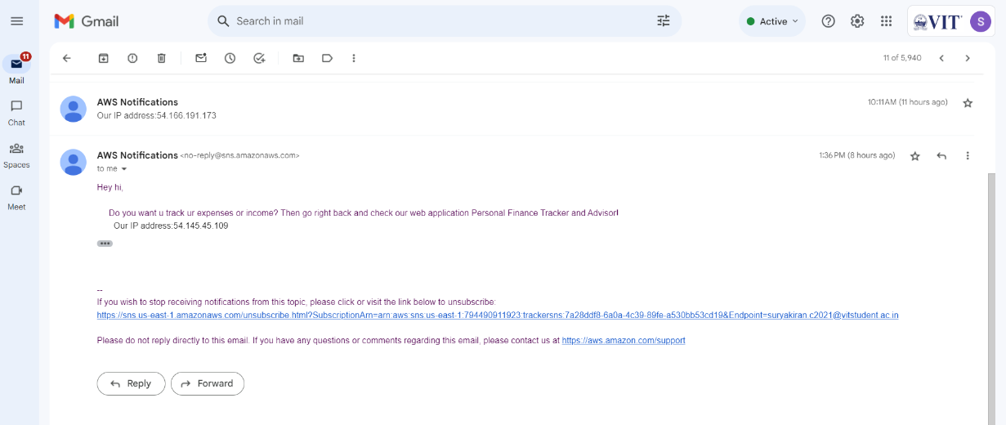
Mail using SNS:

Slide 26
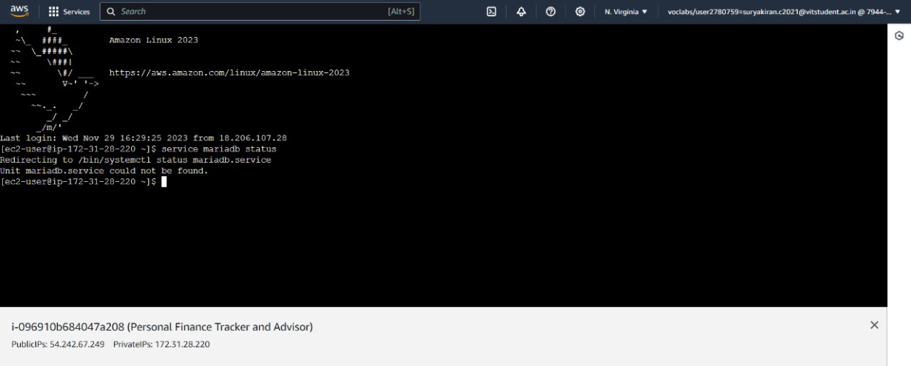
Error Screenshots
Couldnt Connect RDS via mariadb/sql to store data in our web application using rds :

Slide 27
Live Demo and Future Scope:
We Invite you use our Personal Finance Tracker and Advisor application and track your expenses and income and get adivces.
Enhanced Machine Learning Integration:
Explore incorporating machine learning algorithms to provide more accurate and personalized financial advice based on user behavior patterns.
Implement advanced budgeting tools, including predictive budgeting, integrate with banking API'sautomated expense categorization, and real-time spending insights.

Slide 28

Q&A Session:
Thanks for joining us today! We hope you found our presentation informative and engaging. Do you have any questions? We'd be happy to answer them for you :)

Slide 29

Chada Yashodhan -21BRS1456
Krishna Vyas -21BAI1715
Varanasi Sai Charan -21BCE5870
Surya Kiran C -21BCE1110

